Slide 1
Department of Buildings Establishment Act of 2018
Kathy Zeisel

Slide 2
Agenda
Why DC Needs a New Department of Buildings
The Proposed New DC Law
Making the New Law Stronger
Discussion

Slide 3
The Problem

Slide 4
Why DC Needs a New Department of Buildings
DC Residents cannot rely on DCRA to provide meaningful housing code inspections, respond to tenant concerns, and provide housing code enforcement in a strategic way
This Photo by Unknown Author is licensed under CC BY-ND

Slide 5
Why do we need a Department of Buildings?
The Fire at Kennedy Street illustrated how broken DCRA is:
  Failure to have enough inspectors
  Poor culture that does not promote accountability
  Poor communications within the agency and general failure to respond
  Inability to appropriately supervise licensed and unlicensed properties
  Failure to use data in a meaningful way to inform strategic and proactive inspections

Slide 6
DCRA Fails to Protect Tenants
DCRA has no culture of protecting tenants through meaningful inspections or enforcement
DCRA rarely conducts inspections and re-inspections
Landlords know DCRA won’t enforce the housing code, so they continue to provide unhealthy housing to DC residents at high prices
Tenants have to call multiple agencies to have their homes inspected for unsafe conditions like lead, mold, and pests

Slide 7
DCRA’s Inspection and Enforcement is not Strategic nor Efficient
DCRA has no ability to gather reliable data through high quality inspections
DCRA does not track data to identify hot spots or areas of poor housing conditions
DCRA does not use a public health lens compounding the effects of poor housing conditions on tenants
Proactive inspections are not completed in a strategic way

Slide 8
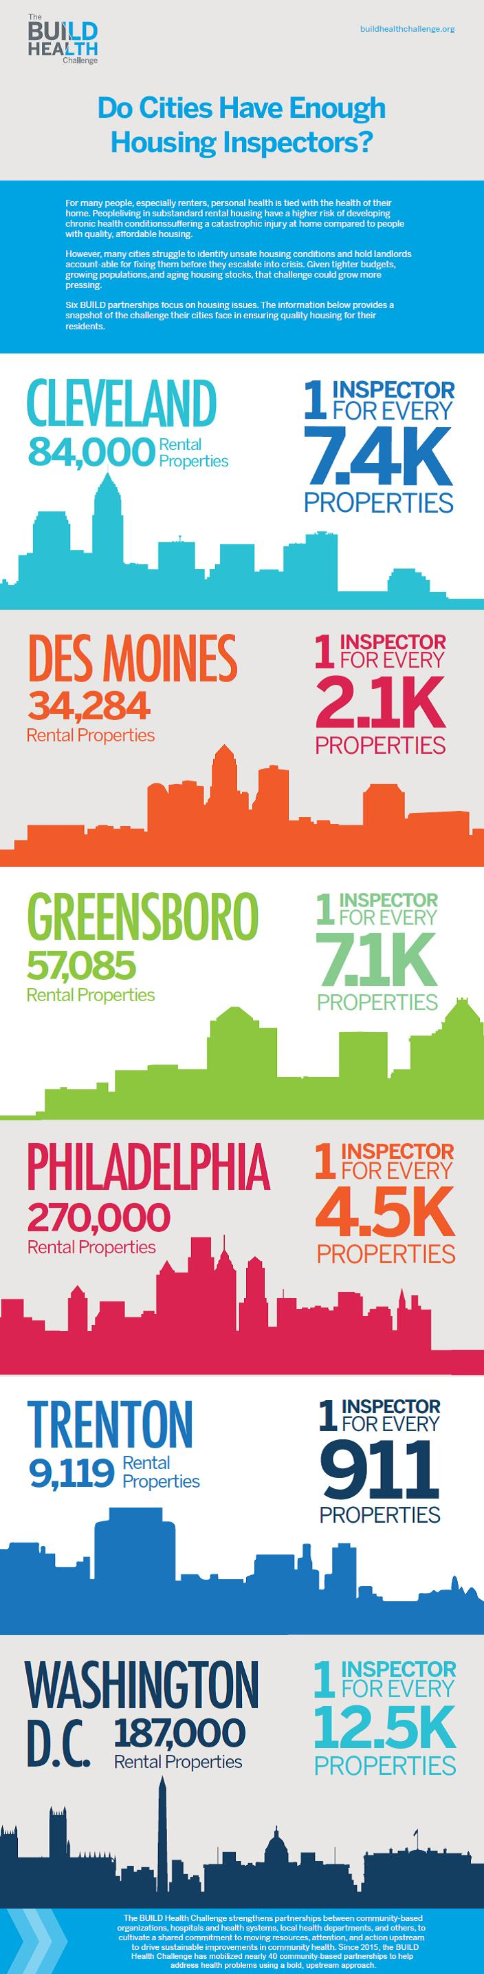
DCRA is Under-staffed and Under-resourced
Quick comparison:
Trenton
  1 : 911 properties
Philadelphia
  1 : 4,500 properties
Washington DC
  1 : 8,100 properties

Slide 9
The Current Proposed DOB

Slide 10
Proposed DOB Law
Establishes a new Department of Buildings with oversight of:
  Construction Compliance
  Rental Housing Safety
  Residential Property Maintenance
The new DOB will:
  Ensure physical environment and structure of all buildings in DC meet regulations and codes
  Ensure the habitability and sanitary condition of all rental housing in DC

Slide 11
Proposed DOB Law
Creates a Director of Strategic Enforcement to:
  Monitor violations, inspection and reinspection
  Use data driven techniques – monitoring violations, etc.
  Manage violations and enforcement

Slide 12
Concerns with the Proposed Law
Lack of structure to ensure sufficient change
No meaningful enforcement requirements
Not enough to change culture of current DCRA
Not enough tenant protections built into the new system

Slide 13
Proposal to Strengthen Code Enforcement:
A Third Agency

Slide 14
Making the New Law Stronger
Create a Separate Tenant Protection Agency Outside the Department of Buildings
  Strong, unifying mission of protecting tenants and preserving the condition of affordable housing.
  Creates one stop shop for tenants who can contact one agency for multiple types of inspections
  Helps with creating a culture of consumer protection and promotion of public health

Slide 15
Proposal: A Third Agency or a Stronger DOB

Slide 16
Making the New Law Stronger
Adequately Staff and Fund the Agency’s Inspectors
  Ensure enough inspectors are on staff to provide for initial inspection and reinspection
  Improve technology for better data collection, analysis and implementation of public health focused solutions
  Streamline data collection so all divisions can share and access data
  Look at other agencies best practices for collecting on-site data and information

Slide 17
Making the New Law Stronger
Create a Public Health Division
  Housing inspections are fundamentally about protecting public health and safety
  Ensures individual inspectors, abatement and systemic work of the agency is informed by a public health perspective
  Inspectors licensed in multiple areas including housing code enforcement, lead, mold, asbestos and extermination
  Use good data to create housing hot spot mapping that identifies unhealthy housing clusters for proactive inspection, enforcement, and remediation

Slide 18
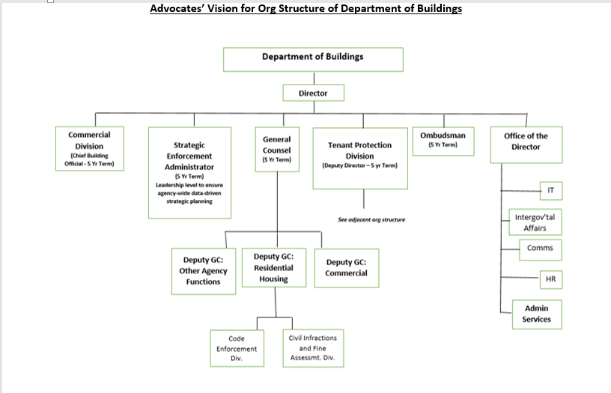

Slide 19
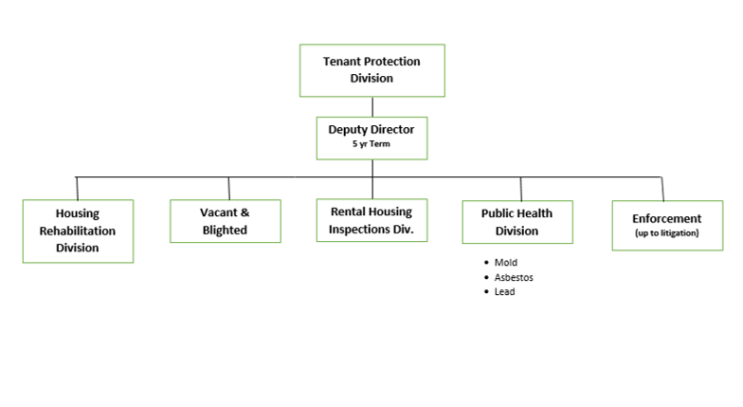

Slide 20
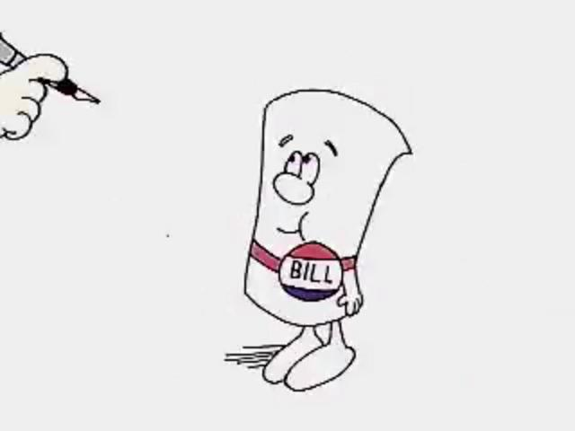
B22-669 Department of Buildings Establishment Act of 2019
Introduced by Chairman Mendelson and Councilmembers Gross, Nadeau, R. White, T. White, Allen, Bonds, McDuffie, Silverman and Cheh
Hearing initially held on April 19, 2018; second hearing held on December 10, 2019 on an Office of Inspector General report that has not yet been released about DCRA and the Department of Buildings

Slide 21
Questions?

Slide 22
Thank You

